Slide 1
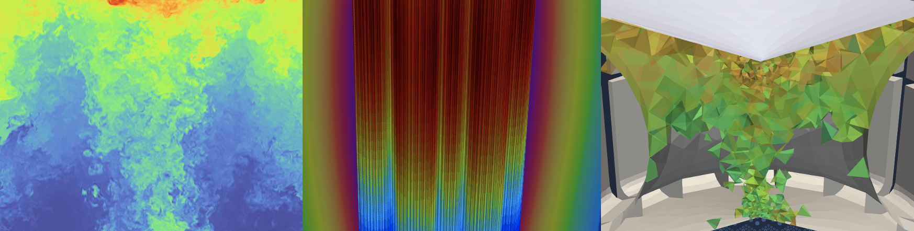
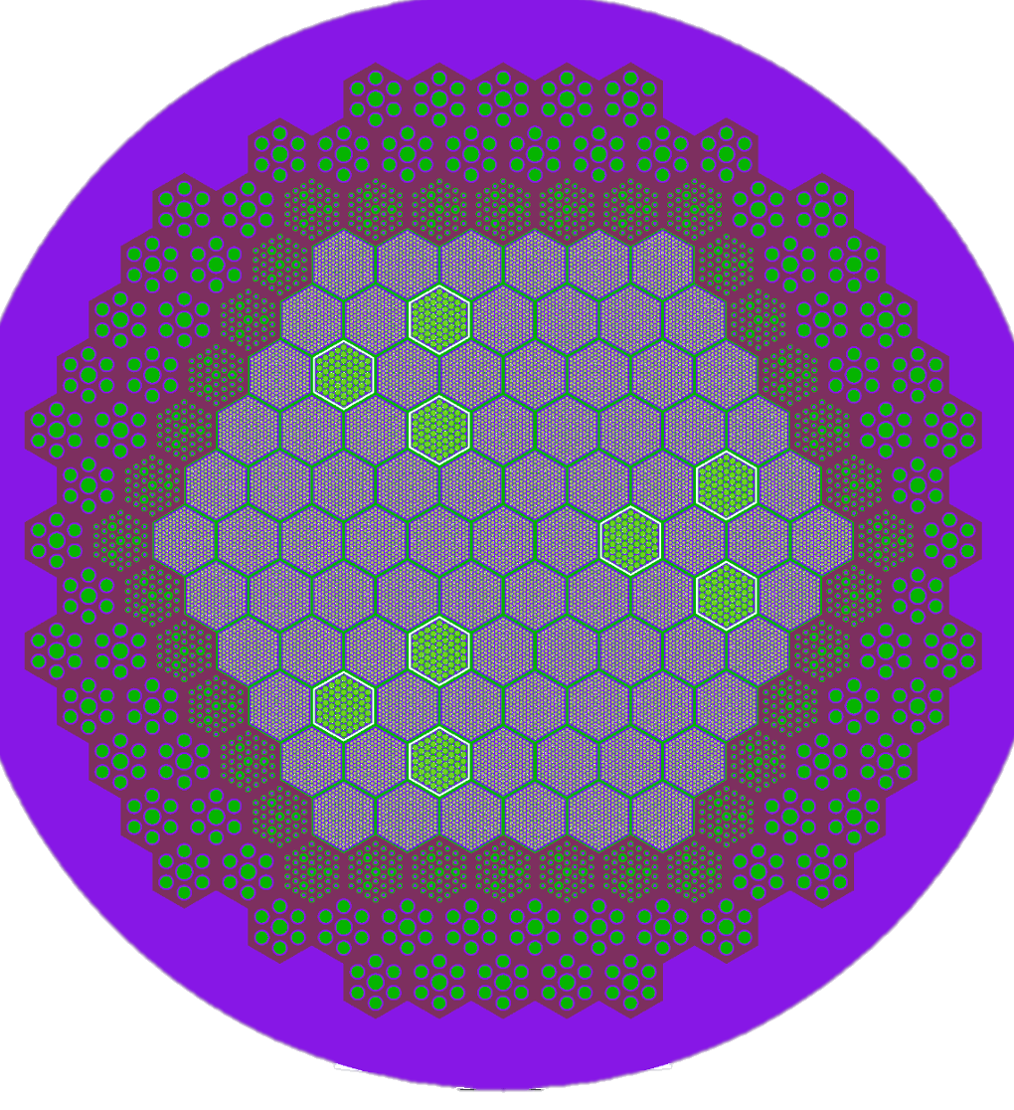
Cardinal: Integrating NekRS with the MOOSE Ecosystem
April Novak
Assistant Professor
Nuclear, Plasma, and Radiological Engineering (NPRE)
University of Illinois, Urbana-Champaign
Joint Appointment, Nuclear Science and Engineering (NSE) Division
Argonne National Laboratory

Slide 2
(Re)-Introduction to Cardinal and NekRS (15 min)
Flow over a pebble, NekRS + MOOSE conjugate heat transfer coupling (75 min)
Notes:
complementary to experimental programs

Slide 3
Objectives:
Introduce how to couple OpenMC to MOOSE
Learn how to apply multiphysics feedback to CAD Monte Carlo models
Explore data postprocessing in Cardinal
Assumptions:
Attended the OpenMC and MOOSE workshop sessions
Basic familiarity with Unix-based environment
Basic familiarity with radiation transport and heat conduction
Notes:
complementary to experimental programs

Slide 4
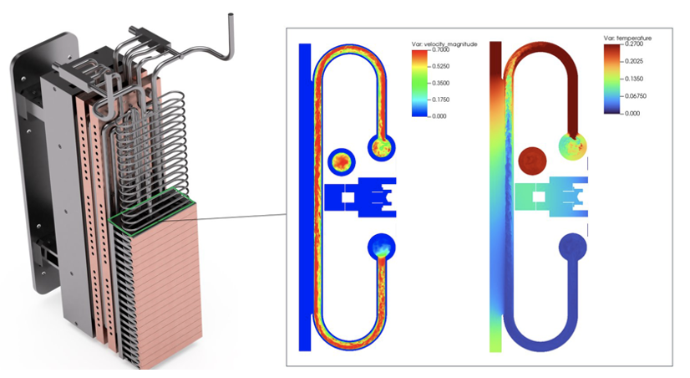
Cardinal
Couples the NekRS computational fluid dynamics code to MOOSE
Open source, extensible for research purposes
Adopt best practices for software development
High performance, scalable on HPC
Can be used to predict:
Heat transfer and fluid flow
Temperature and heat flux thermal limits
Pressure losses and pumping power
Passive scalar transport (e.g., mass transport)
Magnetohydrodynamics
Fluid-structure interaction
and how these are influenced by OTHER PHYSICS
Velocity and temperature in CHIMERA
Simulations performed by Kirk Yuan (ANL), Tri Nguyen (PSU), Elia Merzari (PSU), and Yu-Hsiang Lan (UIUC)

Slide 5
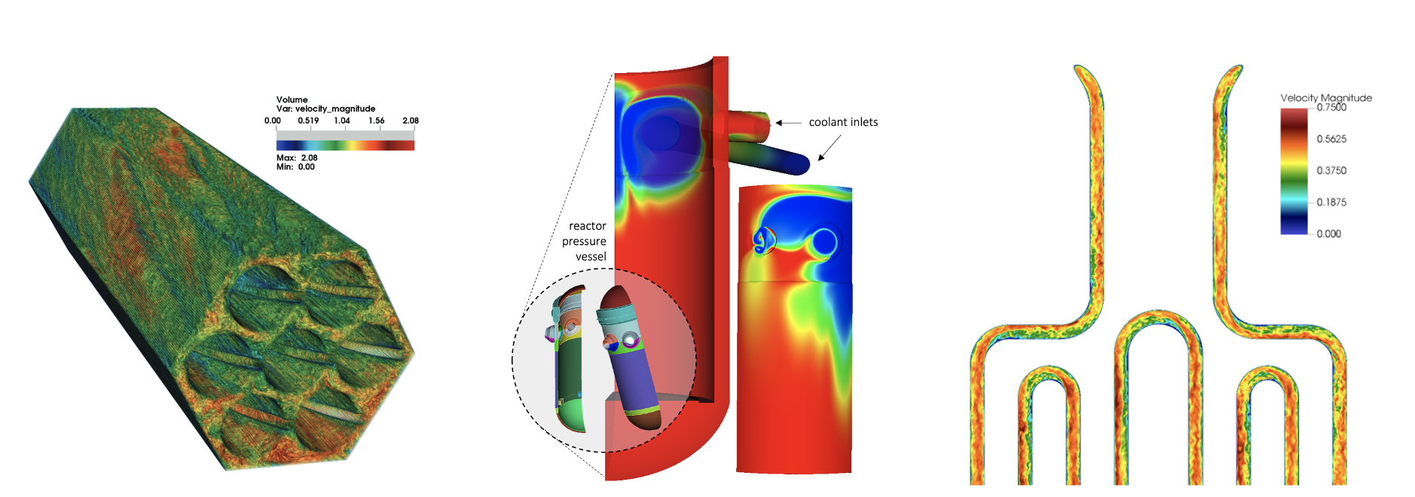
NekRS Integration
Turbulence models: DNS, RANS, LES
DNS flow (including laminar)
RANS flow
LES flow
Fission reactor
Carolina Bourdot Dutra (PSU)
Fission reactor
Yiqi Yu (ANL)
CHIMERA
Kirk Yuan (ANL), Tri Nguyen (PSU), Elia Merzari (PSU), and Yu-Hsiang Lan (UIUC)

Slide 6
NekRS Integration
Turbulence models: DNS, RANS, LES
Coupling modes: boundary (conjugate) heat transfer, volume heat generation, fluid-structure interaction, systems-CFD coupling, forward uncertainty quantification

Slide 7
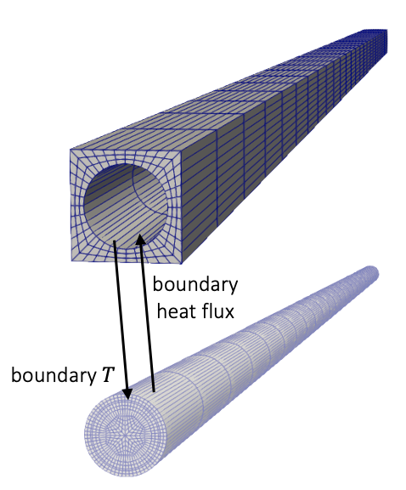
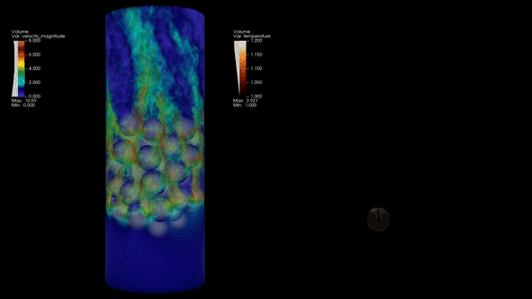
NekRS Integration
Turbulence models: DNS, RANS, LES
Coupling modes: boundary (conjugate) heat transfer, volume heat generation, fluid-structure interaction, systems-CFD coupling, forward uncertainty quantification
NekRS
any MOOSE app
Conjugate heat transfer in a 67-pebble bed.
Courtesy of David Reger and Elia Merzari (PSU).
NekRS + MOOSE heat transfer module

Slide 8
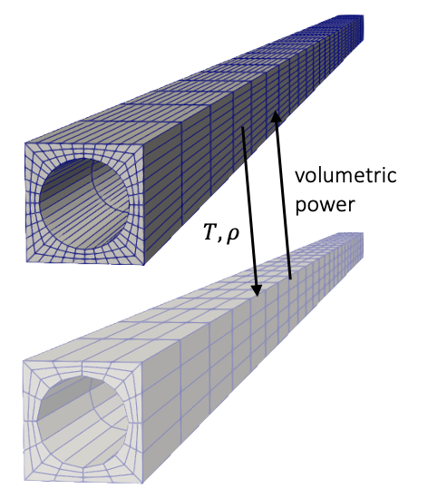
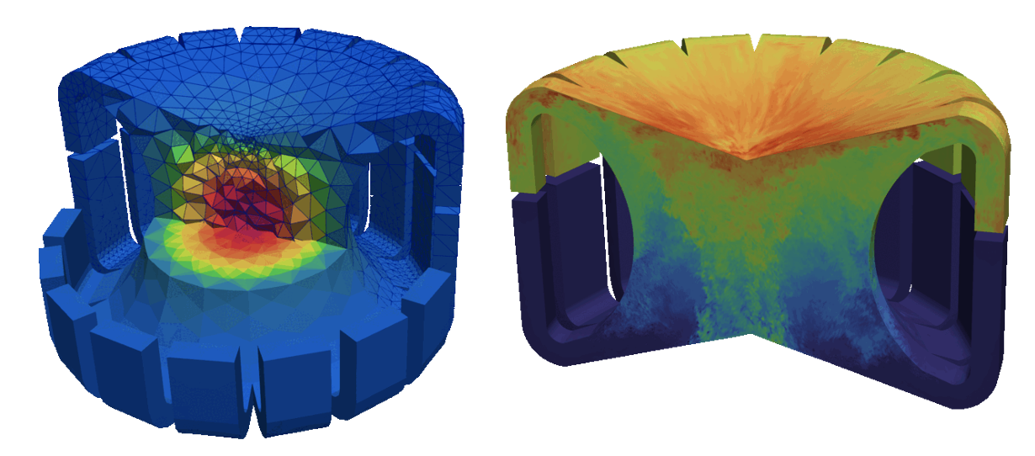
NekRS Integration
Turbulence models: DNS, RANS, LES
Coupling modes: boundary (conjugate) heat transfer, volume heat generation, fluid-structure interaction, systems-CFD coupling, forward uncertainty quantification
NekRS
any MOOSE app
Volume coupling to radiation transport for a molten salt reactor.
NekRS + OpenMC

Slide 9
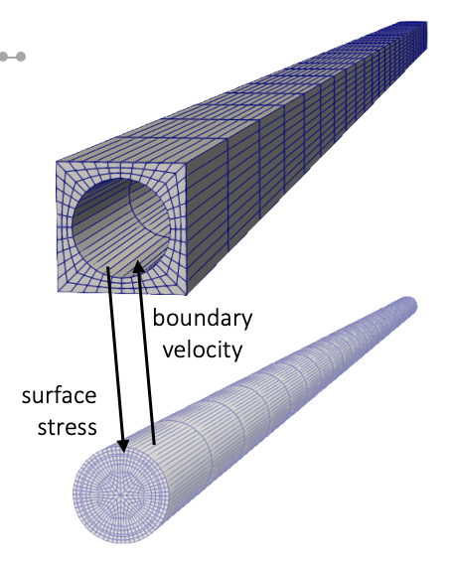
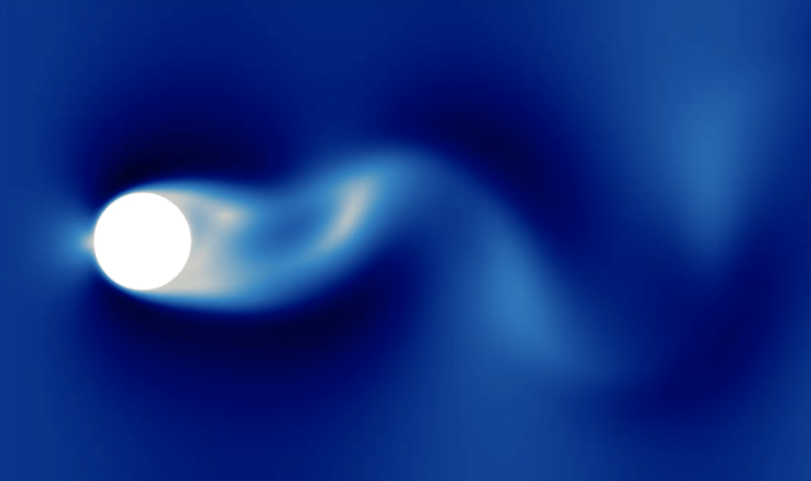
NekRS Integration
Turbulence models: DNS, RANS, LES
Coupling modes: boundary (conjugate) heat transfer, volume heat generation, fluid-structure interaction, systems-CFD coupling, forward uncertainty quantification
NekRS
any MOOSE app
Fluid-structure interaction for cylinder in crossflow.
Courtesy of David Reger and Elia Merzari (PSU).
NekRS + MOOSE solid mechanics module

Slide 10
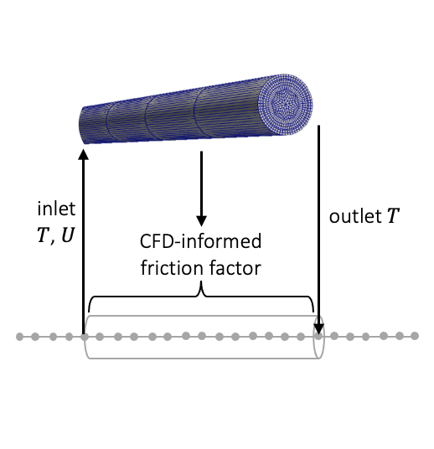
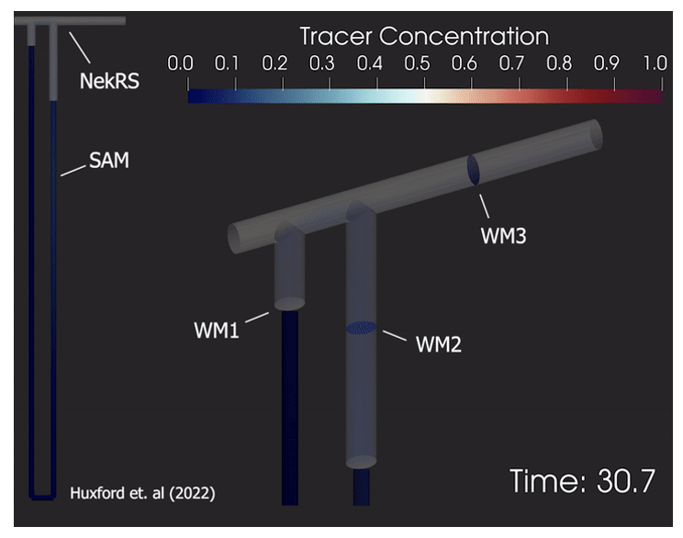
NekRS Integration
Turbulence models: DNS, RANS, LES
Coupling modes: boundary (conjugate) heat transfer, volume heat generation, fluid-structure interaction, systems-CFD coupling, forward uncertainty quantification
NekRS
any MOOSE app
CFD-systems coupling for tracer mixing in a double-T junction.
Courtesy of Aaron Huxford and Annalisa Manera (ETH).
NekRS + SAM

Slide 11
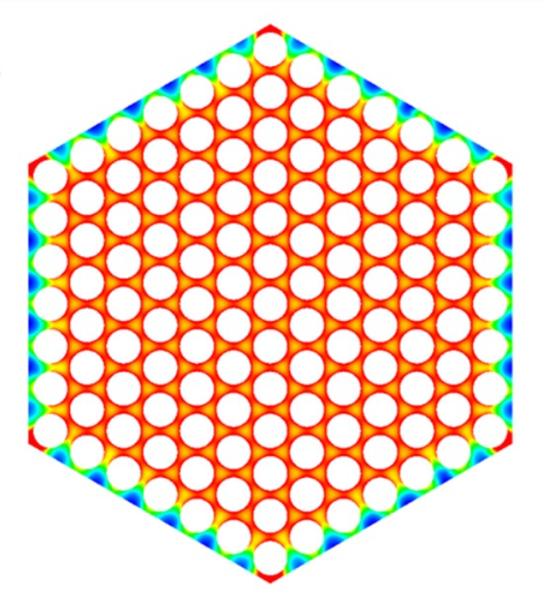
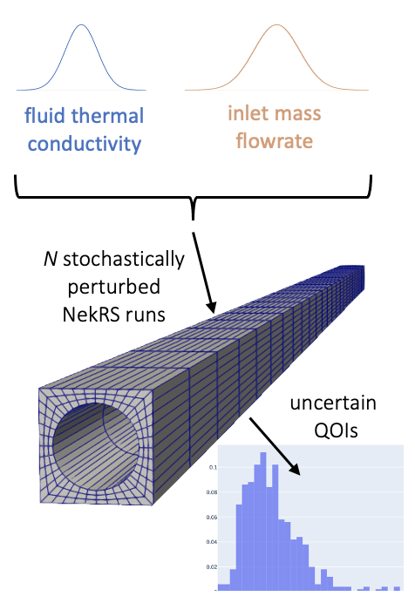
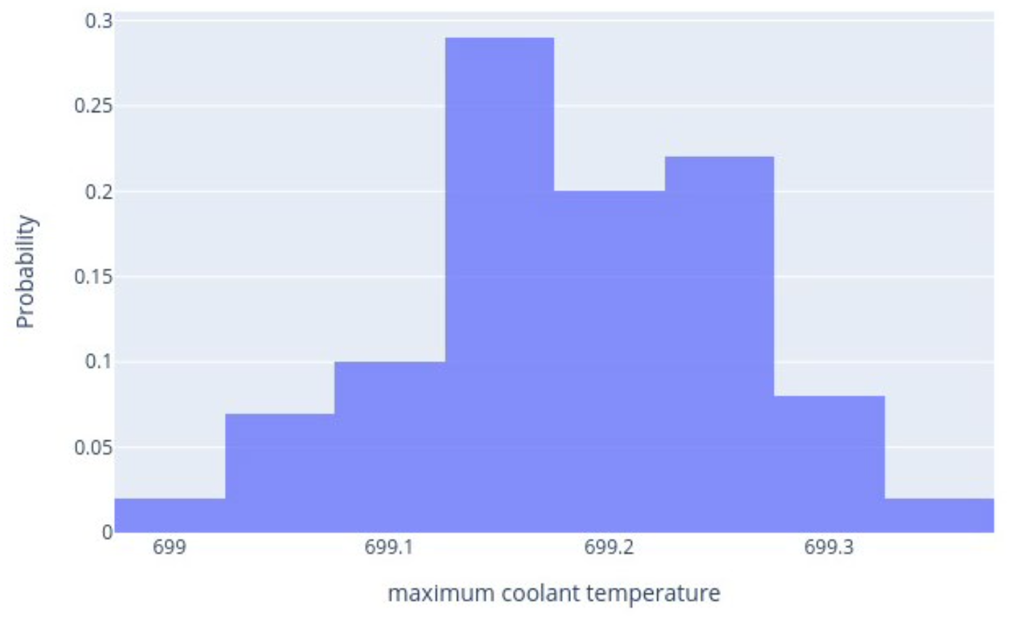
NekRS Integration
Turbulence models: DNS, RANS, LES
Coupling modes: boundary (conjugate) heat transfer, volume heat generation, fluid-structure interaction, systems-CFD coupling, forward uncertainty quantification
Forward uncertainty quantification (UQ) for hot channel estimation in fast reactors.
Courtesy of Hansol Park, Yiqi Yu, and Emily Shemon (ANL).
NekRS + MOOSE stochastic tools module

Slide 12
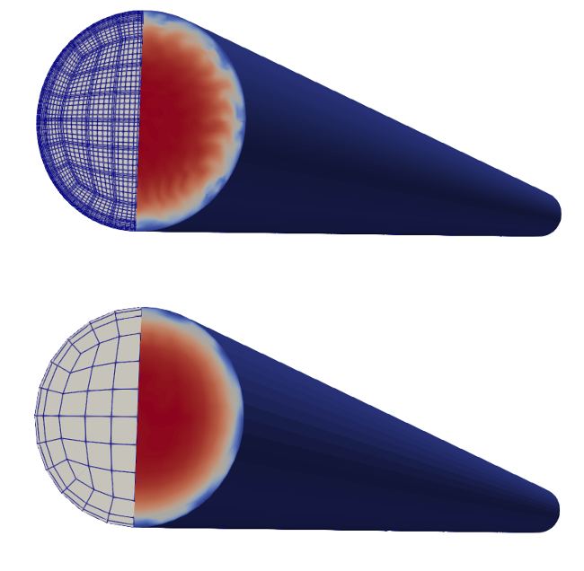
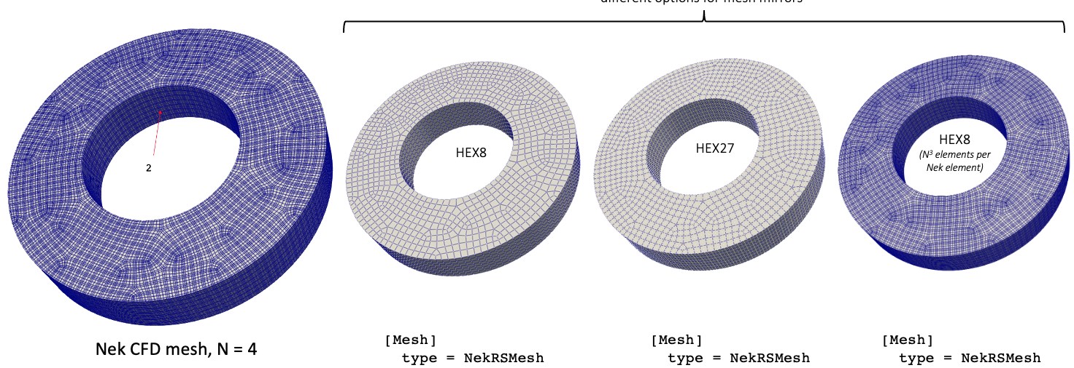
NekRS Integration
Turbulence models: DNS, RANS, LES
Coupling modes: boundary (conjugate) heat transfer, volume heat generation, fluid-structure interaction, systems-CFD coupling, forward uncertainty quantification
Data transfer: interpolate between NekRS mesh and a MOOSE mesh
Data transfer options in Cardinal
Nth order → 1st order
Nth order → 2nd order
exact replication
Example of lowest-order data transfer from NekRS (top) onto a MOOSE mesh (bottom)

Slide 13
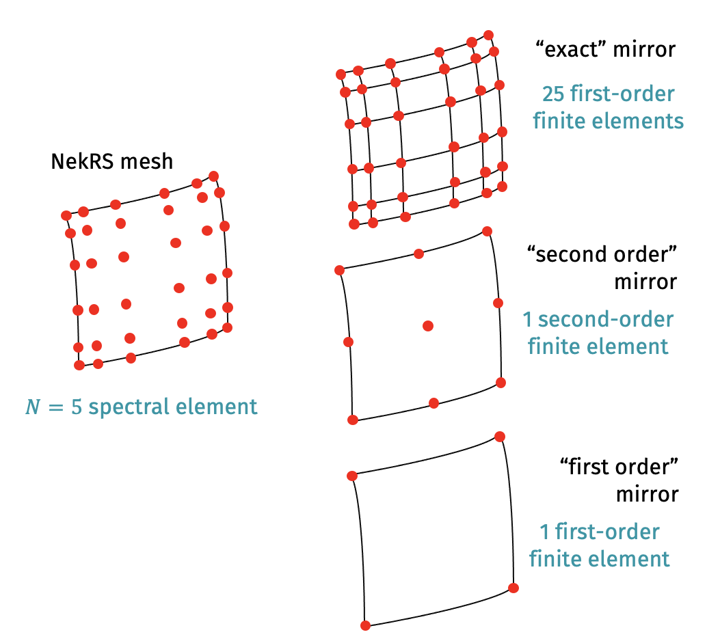
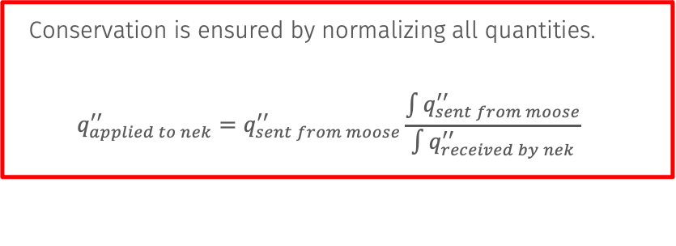
NekRS Integration
Turbulence models: DNS, RANS, LES
Coupling modes: boundary (conjugate) heat transfer, volume heat generation, fluid-structure interaction, systems-CFD coupling, forward uncertainty quantification
Data transfer: interpolate between NekRS mesh and a MOOSE mesh
Conservation is ensured by normalizing all quantities.
$$q_{applied to nek}^{′′}=q_{sent from moose}^{′′}\frac{\int{q_{sent from moose}^{′′}}}{\int{q_{received by nek}^{′′}}}$$

Slide 14
NekRS Integration
Turbulence models: DNS, RANS, LES
Coupling modes: boundary (conjugate) heat transfer, volume heat generation, fluid-structure interaction, systems-CFD coupling, forward uncertainty quantification
Data transfer: interpolate between NekRS mesh and a MOOSE mesh
Parallelism: NekRS runs on CPU/GPU, MOOSE runs on CPU

Slide 15
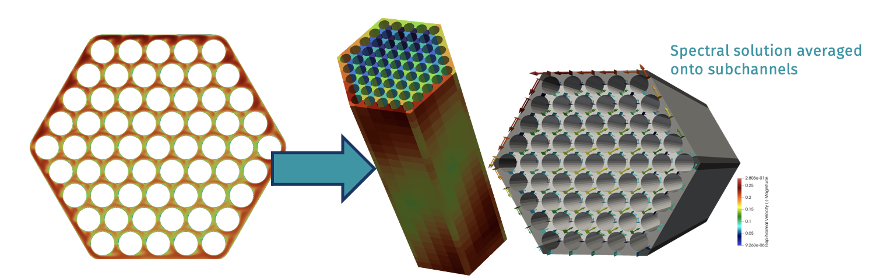
NekRS Integration
Turbulence models: DNS, RANS, LES
Coupling modes: boundary (conjugate) heat transfer, volume heat generation, fluid-structure interaction, systems-CFD coupling, forward uncertainty quantification
Data transfer: interpolate between NekRS mesh and a MOOSE mesh
Parallelism: NekRS runs on CPU/GPU, MOOSE runs on CPU
Other features: Constitutive model development, averaging onto coarse meshes

Slide 16
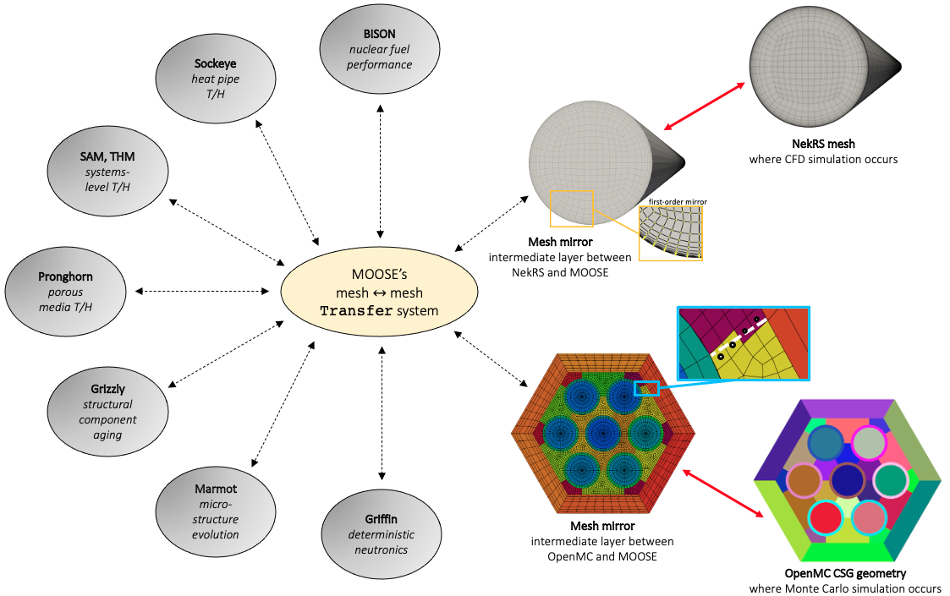
Cardinal
NekRS
wall temperature
fluid density
Write NekRS solution into AuxVariables
Read heat flux, power density, displacement from AuxVariables into NekRS
Allows NekRS to interact with MOOSE for physics feedback and postprocessing
fluid temperature
inlet/outlet BCs
tallies (e.g. power, fluence)
OpenMC

Slide 17
Cardinal
NekRS
wall heat flux
Write OpenMC tallies into AuxVariables
Read temperature, density, displacement from AuxVariables into OpenMC
Allows OpenMC to interact with MOOSE for physics feedback and postprocessing
power density
inlet/outlet BCs
density
temperature
geometry
composition
OpenMC

Slide 18
Docker Instructions
To test if Docker works:
cd openmc/live
cardinal-opt -i testing.i

Slide 19
Compiling Cardinal (After the workshop!)
git clone https://github.com/neams-th-coe/cardinal.git
cd cardinal
./scripts/get-dependencies.sh
./contrib/moose/scripts/update_and_rebuild_petsc.sh ./contrib/moose/scripts/update_and_rebuild_libmesh.sh ./contrib/moose/scripts/update_and_rebuild_wasp.sh
export NEKRS_HOME=$HOME/cardinal/install/bin
make -j8
Compile all dependencies with a single make command, which gives you:
Cardinal executable (cardinal/cardinal-opt)
“standalone” OpenMC executable (cardinal/build/openmc/bin/openmc)
“standalone” NekRS executable (cardinal/install/bin/nrsmpi)
Nek5000 tools (exo2nek) are used to prepare meshes:
git clone https://github.com/Nek5000/Nek5000.git
cd Nek5000/tools
./maketools exo2nek
download the Cardinal source code
download the OpenMC and NekRS
source code
build MOOSE 3rd-party dependencies
set environment variable
compile Cardinal

Slide 20
How to Get Involved
Git repository:
Cardinal: https://github.com/neams-th-coe/cardinal
NekRS: https://github.com/Nek5000/nekRS
Discussions page:
Cardinal: https://github.com/neams-th-coe/cardinal/discussions
NekRS: https://github.com/Nek5000/nekRS/discussions
Documentation:
Cardinal: https://cardinal.cels.anl.gov/
NekRS: https://nekrsdoc.readthedocs.io
Contact us directly!
April Novak: ajnovak2@Illinois.edu (Cardinal lead)
Dillon Shaver: dshaver@anl.gov (Nek lead)

Slide 21
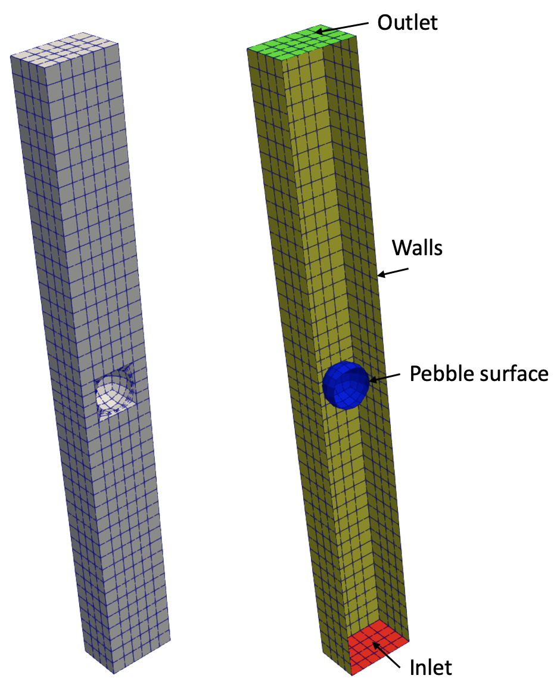
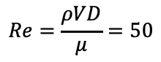
Example: Flow Over a Pebble
Link: https://cardinal.cels.anl.gov/tutorials/cht5.html
pebble diameter: 3 cm
box dimensions: 5 cm x 5 cm x 43 cm
water fluid
Intro to conjugate heat transfer coupling (75 min)
Objectives:
How to couple NekRS to MOOSE for conjugate heat transfer
How to visualize output files
$$Re=\frac{ρVD}{μ}=50$$

Slide 22
NekRS Input Files
<case>.re2: mesh (Hex8 or Hex20)
<case>.par: high-level settings for the equations, time stepping, I/O, …
<case>.oudf: OKL-language “kernels” that run on “backend” (e.g. GPU)
boundary conditions
any other user-specified physics
<case>udf: C++ user interaction which runs on the “host” (e.g. CPU)
initial conditions
postprocessing
pass stuff between device (GPU) and host (CPU)
Optional:
<case>.usr: Fortran backend to access Nek5000 features
A note on naming conventions:
o_name and name hold the same data, but o_name is on the device (GPU) whereas name is on the host (CPU)

Slide 23
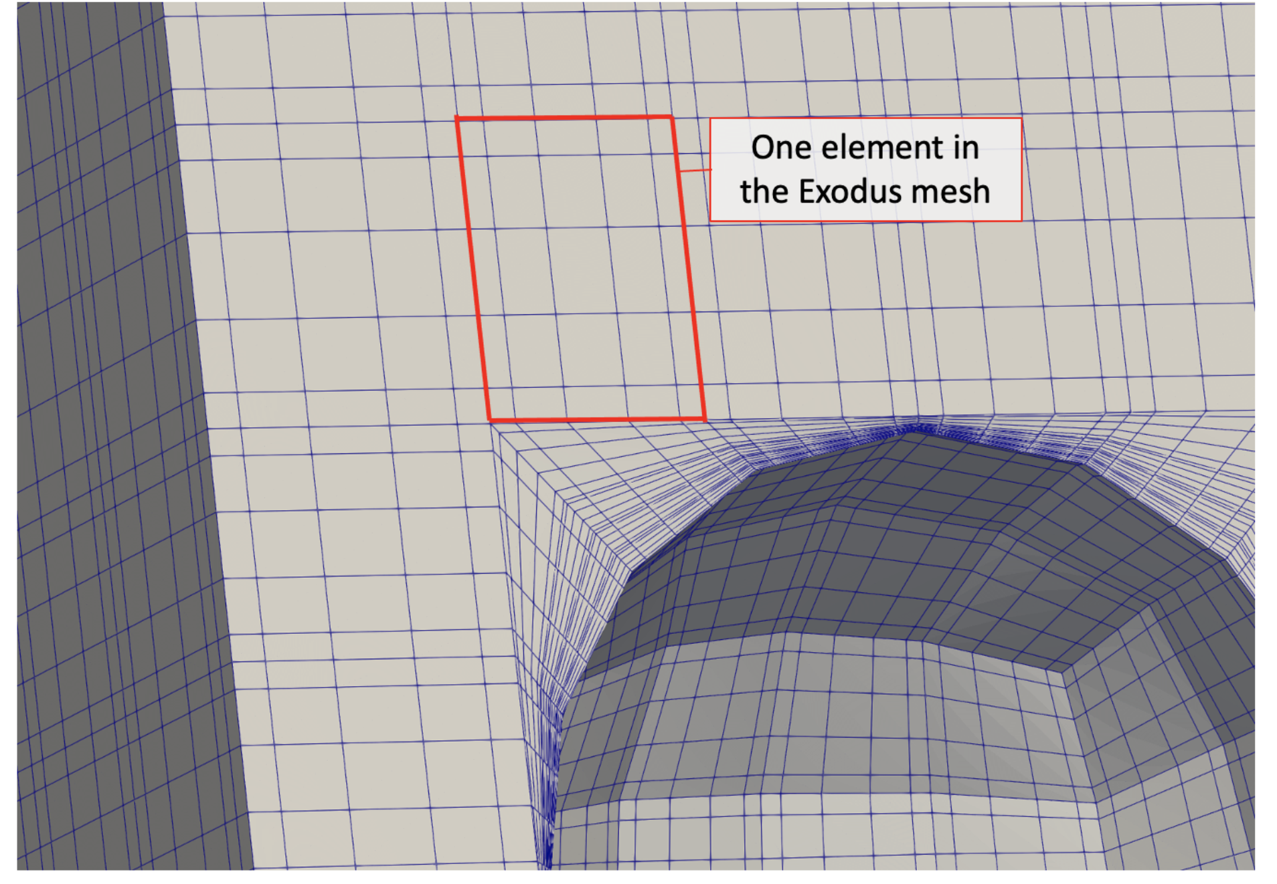
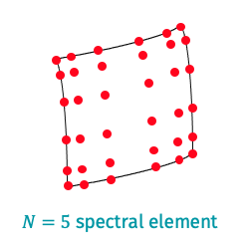
Geometry: pebble.exo, pebble.re2
The mesh Nek uses internally
Mesh must be 3-D
Sidesets must be numbered consecutively, beginning from 1
1: inlet
2: outlet
3: pebble surface
4: walls
The mesh you create

Slide 24
Parameter settings: pebble.par
High-level settings for solver, boundary conditions, and equations to solve

Slide 25
Kernels and boundary conditions: pebble.oudf
Boundary conditions are specified using kernels connected to the choices made in the .par file
The only difference now is that we are not going to hand-write the heat flux value – it’s going to come from MOOSE!

Slide 26
Initial conditions and user interfaces: pebble.udf
UDF_LoadKernels will load any user-defined physics kernels
UDF_Setup is called on initialization, typically where initial conditions are applied
UDF_ExecuteStep is called each time step, typically where postprocessing is applied
Commonly-used variables: https://nekrsdoc.readthedocs.io/en/latest/commonly_used_variables.html

Slide 27
Legacy backend: pebble.usr
Fortran file to perform custom user actions - will eventually be deprecated, but still widely used to streamline porting from Nek5000 to NekRS

Slide 28
Solid heat conduction: solid.i

Slide 29
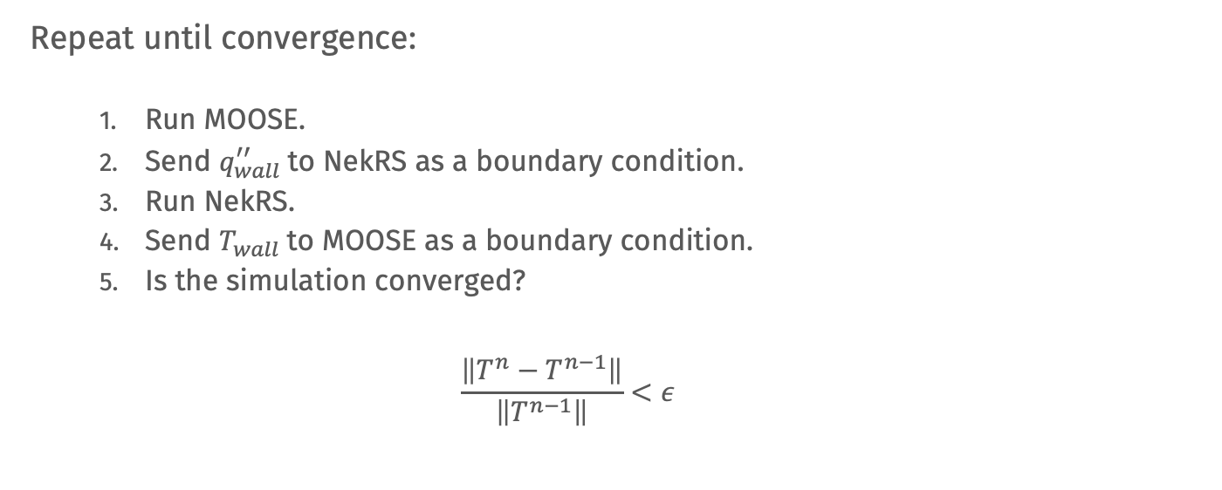
Multiphysics Coupling
Repeat until convergence:
Run MOOSE.
Send $q_{wall}^{′′}$to NekRS as a boundary condition.
Run NekRS.
Send $T_{wall}$to MOOSE as a boundary condition.
Is the simulation converged?
$$\frac{\left\|T^{n}−T^{n−1}\right\|}{\left\|T^{n−1}\right\|}<ε$$

Slide 30
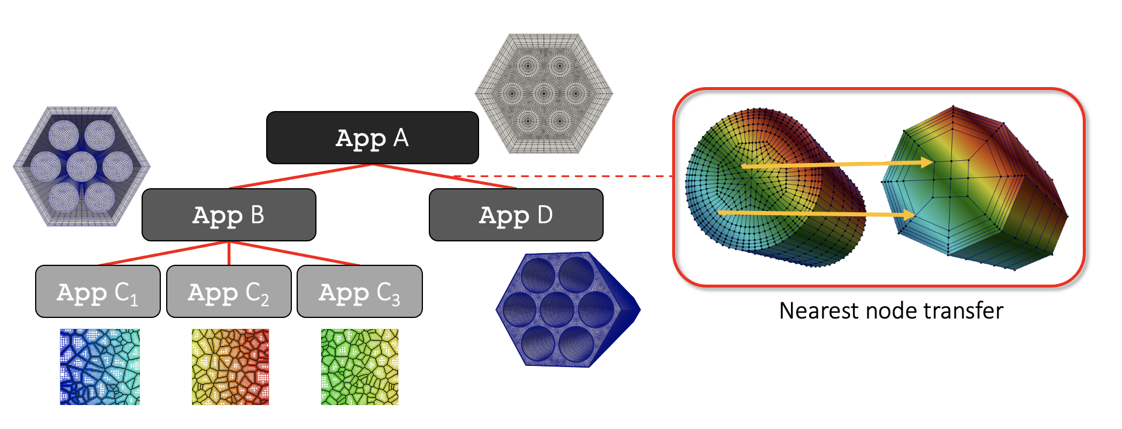
MultiApps and Transfers

Slide 31
Sub-cycling
MOOSE MultiApps can use “subcycling”
Each application can use its own time steps
Synchronization (i.e. data transfers) according to the parent app’s time stepping
0
1
2
3
4
5
Parent application
Child application
0
0.6
1.1
1.7
2.6
3.6
4.6
0.2

Slide 32
Sub-cycling
MOOSE MultiApps can use “subcycling”
Each application can use its own time steps
Synchronization (i.e. data transfers) according to the parent app’s time stepping
0
1
2
3
4
5
Parent application
1.0
2.0
3.0
4.0
5.0
Child application
0
0.6
1.1
1.7
2.6
3.6
4.6
0.2

Slide 33
Coupled Model: solid.i, nek.i

Slide 34
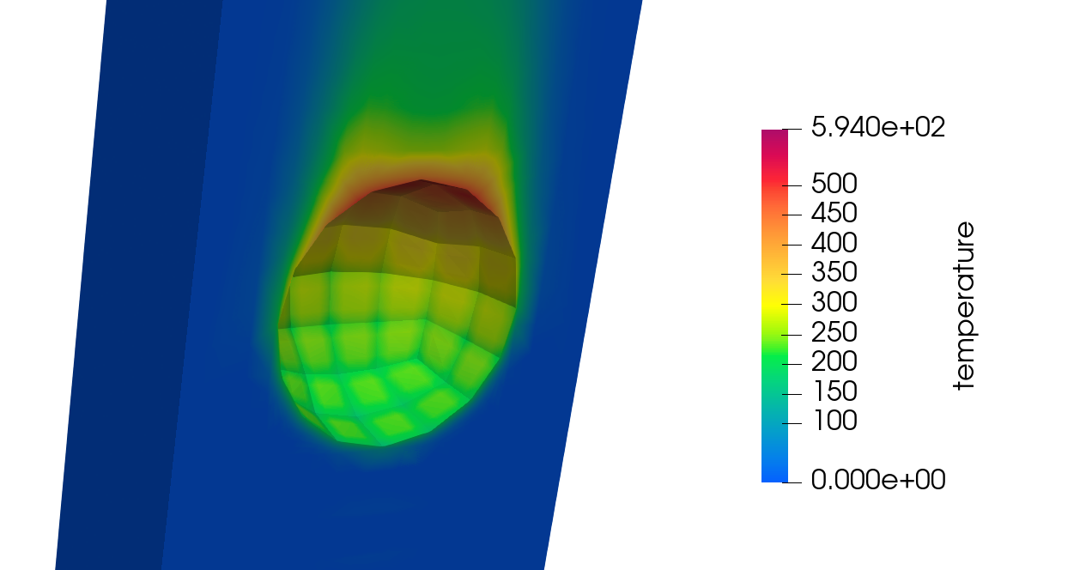
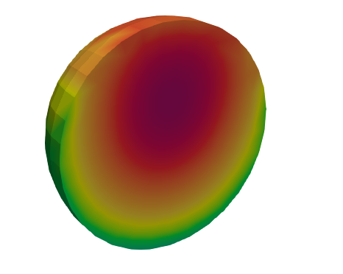
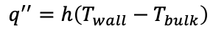
Calculate a Heat Transfer Coefficient
$$q^{′′}=h\left(T_{wall}−T_{bulk}\right)$$

Slide 35
Cardinal couples NekRS to MOOSE for multiphysics feedback and data postprocessing
Additional tutorials which couple NekRS to MOOSE: https://cardinal.cels.anl.gov/tutorials/index.html

